Slide 1
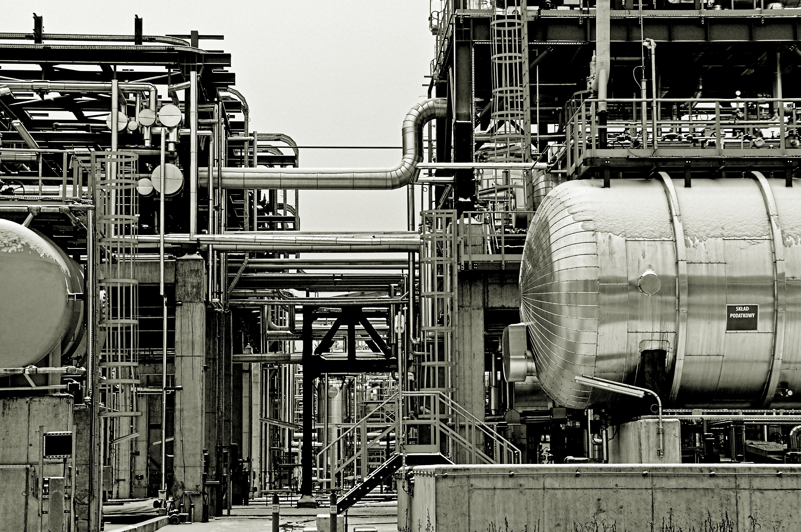
Dialogue against fear How can we maintain good communication in everyday work despite social distance? Tips and suggestions from
etalon international GmbH
Elke Werner-Keppner

Slide 2
Whenever possible, give explanations about your decisions - this makes it easier to accept and implement measures that are sometimes difficult to understand and / or difficult to implement.
Make sure that there is a concrete discussion of your (daily) crisis information in all areas concerned and also ask how the reactions to yesterday's information were.
Communicate clear rules and commandments - there is less resistance than prohibitions
Tell them what you expect employees to do now, what behaviours are helpful in the current situation. Be as specific as possible here.
Agree on clear communication channels across all hierarchies and in all departments.
Also hear the voice of those affected: Invite individual employees to the crisis meeting if they have specific concerns and issues.
At the crisis meetings
Appreciation, Thanks, Explanations

Slide 3
Dialogue with all Employees
Besides the crisis meeting
As far as possible, get as much routine as possible in the exceptional situation For example, organize regular mini-jourfixes at the beginning of the shift, daily calls at certain times, Skype team calls with colleagues in the home office ...
Structures determine everyday life
Questions can be, for example:
How are we positioned in relation to our work? How do we cope with the job requirement and the protective measures provided? Are there new insights - can we do more or something else? What questions or suggestions are there?

Slide 4
In the daily management dialogue
Participation in personal feelings, personal worries ... How is the family doing? How is the work in the home office?
Care, interest,
responsibility
Be protected on site: If possible, visit your employees at their workplaces in the factories with all the necessary distance and protection. As with the "Safety Walk", time and sympathy and interest in the person means appreciation.
Possible questions:
How do you cope with the protective measures?
Can you use them at work at any time? Do you feel adequately protected?
What suggestions, ideas for more protection do you have?
Have we thought of everything or are there still moments of risk in everyday work that we have overlooked? Which?
What other questions or suggestions do you have?

Slide 5
Keep your favorite Routines as long as possible: The virtual coffee break
As we all know, creative breaks at work are important. The daily chat in the coffee corner can also be held virtually!
Invite your colleagues, take a cup of coffee, tea, water ... and treat yourself and your colleagues to a creative break from work. You need suggestions for subjects? Does anyone know a new corona cartoon? Are there anecdotes from family or friends? Does anyone have a good idea to keep fit at home despite all the current circumstances?
In short, you can discuss actually everything that is said about a cup of coffee in the office on a regular basis.
Stay a Community and try it, it's good for you!

